Slide 1
Topic: Measurement
EQ: How do we calculate the volume of prisms?
Get your VIVO’s
Topic and EQ in Interactive Notebook
NO PHONES OR EAR BUDS
Assessment 1 is due tomorrow
2 topic and EQ’s today
Now complete the following before lesson begins and BE PREPARED TO SHARE:
Fill in as many of the formulas on the formula card as possible
Turn over and sketch or write a question relating to the use of the formula and then solve
Notes:
Explaining this slide: Demonstrate the “type of response”: In 2 minutes (timed), you are going to share with your shoulder partner all of the formulas and examples you have written. You will get 2 mins (timed) to write down any formula/examples that your partners has that you haven’t and vice-versa. You and your partner then need to be prepared to share one formula and example on the board ( only choose 3 )
After marking the roll:
- Use active scanning and intervene if they are not. Use Private dialogue if needed

Slide 2
24
7
30
Date
Topic : Measurement
EQ – How do you find the volume of a prism?
For solids with identical cross-sections
Volume = Area of Base x Height
How do I calculate the volume of a rectangular prism?
Volume of rectangular prism = length x width x height
How do I calculate the volume of a triangular prism?
Volume of triangular prism = ($\frac{1}{2}$base x height of triangular base) x height of prism
Notes:
Need to bring a rectangular and triangular prism to show identical cross section

Slide 3
I Do
7cm
4cm
15cm

Slide 4
We Do- on your whiteboards. Timed 2 mins
7m
12m
7m
Notes:
This is an overt response

Slide 5
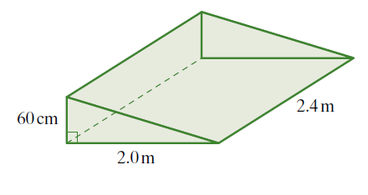
I Do

Slide 6
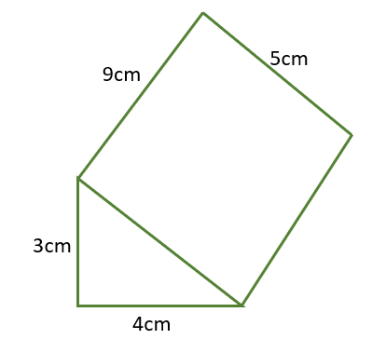
We Do
Notes:
This is an overt response

Slide 7
Gallery Walk- BE PREPARED TO SHARE
You will be asked to find the surface area and volume of 2 prisms
10 mins to complete showing step wise working out
Hang up on whiteboard at the back of room
Notes:
Get a student to re-state the task so that it is clear that it is volume and TSA
An opportunity to provide feedback- immediate, specific and encouraging

Slide 8
You Do

Slide 9
